Slide 1

Java Basics

Slide 2
Classes In Java
In Java, a class is like a blueprint or template for creating objects. Objects are individual instances of a class, and they can have their own properties (data) and behaviors (methods or functions). A class is the blueprint.
Objects In Java
An object is the instance (actual thing created from the class). An object in programming (especially in Java) is like a real-world thing. It has: Properties (data / variables) → what it has, Behaviors (methods / functions) → what it can do?
Class = design/blueprint Object = the actual item created from that design (instance)

Slide 3
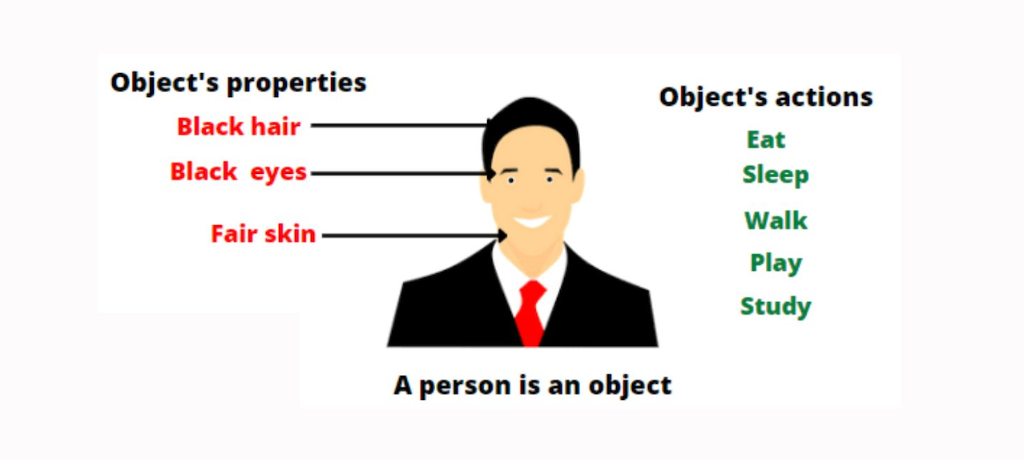
Objects
Example in Real Life:
Think about a Car 🚗
Properties (attributes):
color = “Red”
brand = “Toyota”
speed = 120
Behaviors (actions):
start()
stop()
accelerate()

Slide 4
General Syntax to Create Object
ClassName objectName = new ClassName();
Object creation = Using new keyword to create a real instance of a class.
class Person {
void sayHello() {
System.out.println("Hello");
}
}
Now:
Person → Class name
p → Object name
new Person() → Creates object
Create Object
Person p = new Person();

Slide 5
class Car { String color; String brand; void start() { System.out.println("Car started!"); } } // Creating an object of Car Car myCar = new Car(); myCar.color = "Red"; myCar.brand = "Toyota"; myCar.start(); // Car → Blueprint (Class) // myCar → Actual object created from that blueprint // An object is a real-world thing in programming that has data (properties) and actions (methods).
So, when you create a “Car object” in Java, you are basically making a real car inside memory with its details and actions.
Class = Recipe (How to make a cake)
Object = Actual Cake (The cake you baked using that recipe)
You can make many cakes (objects) from the same recipe (class), and each cake can have different flavors (properties).

Slide 6
a(b())
Inside its parentheses you are passing the return value of another method b() as an argument.
int b() {
return 5;
}
void a(int x) {
System.out.println("Value: " + x);
}
a(b()); // Output: Value: 5
Execution order:
First, b() runs.
Whatever b() returns, gets passed into a(...).
Then a(...) executes using that returned value.
Here b() returns 5, and a(5) runs.

Slide 7
a().b()
Here a is a method that returns an object.
Then you immediately call method b() on that returned object.
Execution order:
a() runs and returns some object.
On that object, you call .b().
class Car {
void start() {
System.out.println("Car started!");
}
}
Car a() {
return new Car(); // a() returns a Car object
}
a().start(); // Output: Car started!
Here a() gives you a Car object, then .start() is called on that object.

Slide 8

Thank You!

